Slide 1
Legal issues for graduate education
Mackenzie Wilfong, Esq.

Slide 2
The U.S. Department of Education is very Busy
Rules, Rules, and more Rules

Slide 3
Get ready for rulemaking and LARGE policy changes
The DOE Office of Postsecondary Education has shared a list of 14 topics selected for future negotiated rulemaking efforts including Pell eligibility for prison education, public service loan forgiveness, gainful employment, financial responsibility for institutions (with lots of comments about the long-term debt rules).
See https://www.federalregister.gov/documents/2021/05/26/2021-11120/negotiated-rulemaking-committee-public-hearings for a full list.
The Department of Education recently announced that beginning this month, it will begin automatically discharging Title IV loans and TEACH Grant service obligations of borrowers and grant recipients who are identified as eligible for Total and Permanent Disability Discharges.
While ED will continue to match data with other federal agencies, borrowers and recipients will no longer submit an application for the discharge. ED also announced that, through a data match with the Department of Defense, it will automate the pause of student loan interest accruals for active duty.
Notes:
My favorite part of working at a University or now a College is the business of the College….I try to take on a topic every year to intensely study….this year was Financial Aid.
Negotiated Rulemaking is a process used by the U.S. Department of Education in which representatives from a government agency and affected interest groups negotiate the terms of a proposed administrative rule. The agency publishes the proposed rule in the Federal Register and then follows the usual rulemaking procedure of soliciting public comments, which are evaluated for inclusion in the final rule.

Slide 4
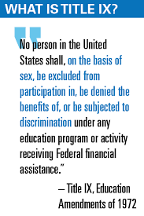
Title IX
The DOE formally announced it will cease enforcement of the portion of the Title IX regulations issued under the Trump Administration that prohibited considering statements of witnesses and parties who would not subject themselves to cross-examination. A Massachusetts district court judge struck down that portion of the campus sexual assault regulations in July.
DOE issued a Notice of Interpretation that Title IX includes discrimination based upon sexual orientation and gender identity.
DOE filings indicate we will see new Title IX regulations in May 2022.
I really doubt it, nevertheless when your policies are revised again be patient with your Title IX Coordinator.

Slide 5
Legislatures were busy too

Slide 6
Revoked Executive Order become Legislative Agendas
On September 22, 2020 President Trump issued an Executive Order that impacted employee diversity training in federal agencies, federal contractors, and for those who use federal grants to support training. The E.O. defined “divisive concepts” including, although not explicitly stating issues of Critical Race Theory.
You may recall we discussed this E.O. last year.
President Biden revoked this E.O. on January 20, 2021. This timing corresponded with the beginning of session for many legislatures.
Currently eight states (Idaho, Oklahoma, Tennessee, Texas, Iowa, New Hampshire, Arizona, and South Carolina) passed legislation similar to the now revoked E.O. None of the state bills that passed mention the words “critical race theory” explicitly, with the exception of Idaho.
This impacted K-12 as well, which of course causes confusion for concurrent enrollment.
State school boards in Florida, Georgia, Utah, and Oklahoma introduced new guidelines barring CRT-related discussions. Local school boards in Georgia, North Carolina, Kentucky, and Virginia also criticized CRT.
Nearly 20 additional states have introduced or plan to introduce similar legislation.
https://www.brookings.edu/blog/fixgov/2021/07/02/why-are-states-banning-critical-race-theory/

Slide 7
Lest we forget
In Sweezy v. New Hampshire, the U.S. Supreme Court highlighted the critical role that academic freedom encompasses including the right to question existing norms and teach about controversial subjects.
“To impose any strait jacket upon the intellectual leaders in our colleges and universities would imperil the future of our Nation. … Teachers and students must always remain free to inquire, to study and to evaluate, to gain new maturity and understanding; otherwise our civilization will stagnate and die.”
Notes:
I have met with numerous Faculty groups in an effort to remind everyone…”To impose any strait jacket upon the intellectual leaders in our colleges and universities would imperil the future of our Nation. … Teachers and students must always remain free to inquire, to study and to evaluate, to gain new maturity and understanding; otherwise our civilization will stagnate and die.”

Slide 8
Leaves of Absence
for students

Slide 9
Recent Settlement
For much of the last ten years, confusion has persisted about whether institutions may take actions, such as placing students on involuntary leaves of absence, when students present threats only to themselves and not others, based on Americans with Disabilities Act (“ADA”) regulatory revisions made by the U.S. Department of Justice (“DOJ”) in March 2011 that expressly addressed threat to others and did not address threat to self.
The U.S. Department of Justice and Brown University entered into a settlement agreement on August 10, 2021.
The Settlement Agreement resolves a compliance investigation involving the readmission of students who took leaves of absence for mental health reasons between Fall 2012 and Spring 2017. The Agreement memorializes Brown’s guidelines on “Clearance to Return from Leave.”
Obligates the University to implement additional training requirements for faculty and staff responsible for evaluating medical leave and/or readmission requests, imposes various reporting obligations on the University, and requires that Brown compensate aggrieved individuals in the amount of $684,000.
Notes:
Due to cohort models, timing for program completion, and other reasons often graduate programs have unique needs when it comes to leaves of absence which may differ from undergraduate needs.
The federal government has not amended either the ADA or the earlier Rehabilitation Act that first regulated colleges and universities to address this concern. Nor have those acts’ implementing regulations been amended in such a way. Suicide and suicide attempts continue to rise, particularly with traditional college-age students. Clear guidance about balancing the interests of a student in their continued enrollment, against their continued safety, is essential.
In 2011, the DOJ amended the ADA Title II regulations, which apply to public institutions of higher education. The amendment mirrored existing Title III regulations, regulating private institutions as one form of a public accommodation, with respect to the concept of “direct threat,” and explicitly permitted institutions to address students who present a “direct threat” to others, while remaining silent on how to analyze a student who presents a threat of harm to him or herself. Under both Titles II and III of the ADA, a direct threat is defined as a “significant risk to the health or safety of others that cannot be eliminated by a modification of policies, practices or procedures, or by the provision of auxiliary aids or services . . . .” There is no statement relating to a threat to oneself. That is where the statutory and regulatory law remains at this time.
Legally it is really confusing how to address leaves of absence when you have threat to self only and then how to certify a return.

Slide 10
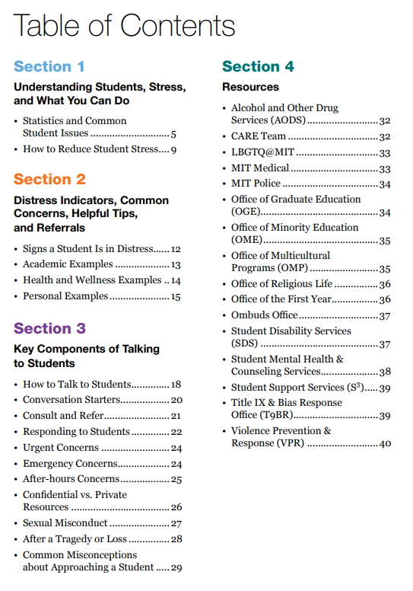
MIT Faculty Guide Recognizing and Responding to Students in Distress
MIT has done important work on its policies and procedures for addressing student self-harming behavior, and one of their most beneficial resources is a Faculty Guide, intended to help faculty recognize signs of a student who is struggling, and enable faculty to provide appropriate referrals and support.
The Faculty guide is very helpful. https://facultyguide.mit.edu/sites/default/files/documents/mit-faculty-guide.pdf
Notes:
Your best bet is to draft a good policy in line with DOJ and DOE guidance….I wanted to highlight a few places I would go if you wanted to see good practices. First, MIT faculty guide….before students even enter into a process particularly graduate students they will talk with their faculty probably faculty advisor first and you want that conversation o go well. It is also not a conversation that happens frequently so a guide to fall back on helps – this one is really excellent. This was drafted by a Department within their Student Affairs group title student support and well being, which is great that they are able to provide such services.

Slide 11
Model Policies and Processes
For public schools Rutgers Safety Intervention Policy was developed in conjunction with OCR.
https://policies.rutgers.edu/view-policies/academic-%E2%80%93-section-10
For private institutions Princeton and Stanford have recently developed policies with DOJ/OCR.
Princeton - https://ua.princeton.edu/contents/academic-standing-leaves-of-absence-and-reinstatement
Stanford - https://bulletin.stanford.edu/academic-policies/undergraduate-degrees-and-programs#leaves-reinstatement1
Matters to keep in mind when drafting or revising
Voluntary, Involuntary, and Return processes – these are three distinct processes
Visa status implications
Disability accommodation considerations
Housing, financial aid, health insurance, and other related service issues
Notes:
Where to start. Reading the DOJ and OCR guidance is helpful but it does not write the policy for you. Focusing on drafted policies which were pre-negotiated is where I would start. I would specifically look at three. More than that and it becomes very overwhelming. When drafting you will need a committee it is just too complicated to not
You need the doers from
International services
Student Affairs including wellness, disability services, housing, student health, student conduct
Financial Aid
Someone from legal
Someone influential who will be around from
Academic Affairs as high as you can get to make it stick

Slide 12
COVID
I promise no discussion regarding masks or vaccines

Slide 13
Class Action Updates
As of September 23, 2021 there are 77 current class action law suits regarding Fees, Tuition, Room and Board regarding the transition to remote learning back in March, 2020.
Since Spring 2020, it is estimated that more than 300 lawsuits have been filed by plaintiffs demanding tuition refunds from colleges and universities after operations pivoted from in-person to online.
Many cases were denominated as breach of contract and unjust enrichment.
There are two cases in Texas one in the Northern District and one in the Western District. For now the litigation in Texas focuses on private institutions.
Oklahoma and a few other states have litigation not captured as a class action but involving numerous defendants.
The American Council on Education (ACE) and 17 other higher education associations in Rynasko v. New York University filed a brief to explain the financial impact of the COVID-19 pandemic on colleges and universities and respond to the false narrative that institutions of higher education profited from or otherwise received a financial windfall from the pandemic.
As of December 2020, institutions reported spending an average of approximately $12 million in COVID-specific expenses while maintaining faculty and staff salaries and confronting unexpected decreases in auxiliary revenue and enrollment.
In total, according to one estimate in the brief, America’s colleges and universities incurred “$24 billion” in COVID-related costs.
Amicus-Brief-US-Court-Appeals-Financial-Impact-Higher-Ed-COVID-08272021.pdf (acenet.edu)
Notes:
17 others include APLU, NASFAA, NACUBO, and others. I included the link because this brief is short and provides all sorts of data regarding cost estimates. It is truly an encapsulation of the nightmare we have all been living.

Slide 14
HEERF Basics
https://www.nasfaa.org/uploads/documents/HEERF_Funds_Comparison_Chart.pdf
Notes:
In the 17 years I have practiced higher ed law this has been the most fascinating legal issues I have ever worked on. From a legal perspective there was no one to ask that knew it better because no one has ever seen anything like HEERF. The DOE seemingly made eight or more versions of an FAQ for Cares 1 alone. They did the best they could, your financial aid or controller’s office must be incredibly exhausted.

Slide 15
HEERF - Numerous Reporting Mechanisms
Institutions must report publicly on their primary websites on a quarterly basis for both student portion and institutional portion funds.
Annual reporting
Institutions are required to submit an annual report to the Department by February 8, 2021, covering CARES Act HEERF grant expenditures in calendar year 2020.
HEERF II and III are due in early 2022. There is currently a lot of discussion about the information required in this annual report, and the DOE has not yet determined the requirements.
Bottom Line – you should be able to google your institution and see the quarterly reports.
Many states and/or Legislatures are also requiring distinct reporting.
For institutions who receive Title IV funds (financial aid) this will also show in your single audit.
Any non-Federal entity, including private nonprofit and public institutions, that expends $750,000 or more during the non-Federal entity’s fiscal year in Federal awards, including student financial assistance under Title IV of the Higher Education Act of 1965, as amended (Title IV) and HEERF, must have a single audit conducted in accordance with 2 CFR part 200 Subpart F Audit Requirements. See https://www2.ed.gov/about/offices/list/ope/heerfauditletter.pdf
Notes:
For a research, transparency, or accountability perspective there are a host of places to look for this information that don’t require an open records request. I personally have found three of the most interesting pieces of data to be
What criteria did the school use to disburse student portion – was it a sliding scale with estimated family contribution from FAFSA….Pell eligible….or just across the board? How have you dealt with international or DACA when you were allowed to provide it with HEERF III? I think it is an interesting insight into what institutions value.
How institutions have used the institutional portion. Did they use it to defray lost revenue with housing, bookstore, meal plans….Did they ameliorate student debt owed to the institution? Did they spend it all on transitions to remote learning, COVID protocols? It is literally all over the map. The one thing they can’t use it on is capitol expenditures other than air handling for COVID….
Who determined these priorities – via faculty committee, just a CFO call??? There is no reporting on this issue – I would love if someone did research on this issue of how these decisions were made.

Slide 16
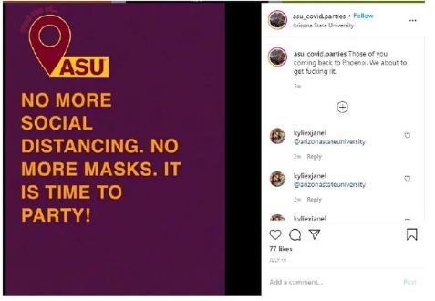
Arizona is sometimes awesome
The Board of Regents governing ASU, brought a trademark case against defendant “Doe” who posted a series of really vulgar Instagram messages featuring the University’s logo and colors attempting to persuade college students to attend maskless COVID parties during the peak of the first wave of the pandemic.
U.S. District Judge Dominic Lanza said the university’s “novel use of trademark law” claims didn’t hold up because no reasonable person would be deceived by Doe’s use of the university’s logo and school colors.
“Many things can be said about these offensive and outrageous statements,” Lanza wrote, “but it is not plausible (to put it mildly) that a reasonably prudent consumer would believe ASU was the source or origin of them.”
Notes:
As a brief reprieve…..Arizona is something really awesome…..this to me takes the cake for most creative use of the law in trying to address a COVID related concern….not so successful but totally creative.
The filing was rife with insults for ASU’s lawyers and Nazi references for ASU officials. More substantively, though, Doe claimed First Amendment protection for the Instagram account. The posts were “clearly a parody,” Doe said. “The 1st Amendment allows me to be as offensive as I want to be. So suck it!“
Doe sent an email to ASU counsel Glenn Bacal and Sean Garrison of Bacal & Garrison Law Group. “I heard in the news that you guys are trying to sue me,” the profanity-laced email said. “Withdraw your complaint or I will file a Rule 11 motion for sanctions....I am extremely experienced and outrageously vexatious.”
Lanza struck the answer to ASU’s complaint because it was “filled with obscenities, inflammatory language and insults directed toward ASU and its counsel.” The judge ordered Doe to file a revised response without curse words and gratuitous vituperation. He also instructed Doe to file a motion explaining why he or she is entitled to continue litigating anonymously. (Doe’s answer cited the First Amendment but Lanza said that was an insufficient justification.) Doe never filed anything else.

Slide 17
A few Fascinating cases
From my humble perspective

Slide 18
Growing number of claims, still unsuccessful
Just last month we saw two nearly identical claims dismissed in favor of the institution.
The facts in both cases were very similar Plaintiff, a former student at the University brought contract and tort claims against the University after the University dismissed plaintiff from its Ph.D. program for failing to make progress on student’s dissertation/failing to complete degree requirements pursuant to standard academic expectations.
Rossi v. Univ. of Utah (Utah Aug. 12, 2021)
Colvin v. Howard Univ. (D.C. Aug. 19, 2021)
Notes:
Observationally these cases are exhausting for faculty and advisors. Are normally really factually specific. Take like 6-10 years to litigate. Institutions typically prevail, but at a significant cost, which is worth it but…..there do seem to be a lot more of these to discuss.

Slide 19
Unique research issue after faculty passing
Plaintiff, a family member of a former University of Washington employee who died due to causes unrelated to the litigation, brought an action against the State of Washington and the University related to the employee’s research on an RTN cell line.
Plaintiff alleged that the University breached a contract, tortiously interfered with a contract, and converted property by disposing of the cell line and dissolving a licensing agreement after the employee’s death.
The court found that the deceased employee had assigned his rights to the RTN cell line to the University, and the now-deceased employee was the only person with the unique knowledge and experience to identify, ship, and explain the RTN cell line.
These two facts absolved the University of any obligation to find a new buyer for the cell line or allow others to care for the cell line (breach of contract claim), continue the licensing agreement (tortious interference claim), or maintain the cell line in contravention of the University’s standard biohazard protocol, which specified safe methods of disposal (conversion claim).
Singh v. State (Wash. App. Aug. 16, 2021)
Notes:
It begs the really unfortunate question of does your College or University have transition plans for specific highly technical research. Things we wish we were not thinking more about, but we are thinking about them.

Slide 20
Accommodations
A former student at Pacific University who has cerebral palsy, appealed a district court determination that the University acted lawfully under Section 504 of the Rehabilitation Act and Americans with Disabilities Act when it asked about plaintiff’s functional limitations in the application process for a Ph.D. of Clinical Psychology program and declined to provide plaintiff with her requested accommodation of a paid personal assistant.
Notably the University granted appellant all other requested accommodations during the time she was enrolled.
Practical lesson - consulting with Accessibility Resources is critical when you see unique accommodations, a paid personal assistant is a unique accommodation.
Breyer v. Pac. Univ. (9th Cir. Aug. 27, 2021)
Notes:
Everyone I talk to is seeing a spike in the request for mental health services and accommodations on campus. This is just a nice reminder that Accessibility resources, disability services, whatever it is called we need to remember that they are the experts…..and not all requests are reasonable. We all are reluctant to deny requests.

Slide 21
United Educators large loss report 2021

Slide 22
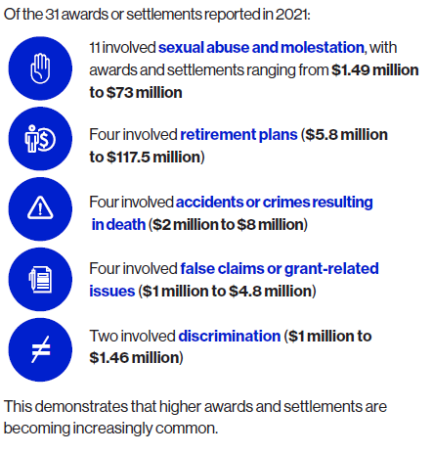
Large Loss Statistics
https://www.ue.org/uploadedFiles/Large-Loss-Report-2021.pdf
Notes:
Insurance premiums for institutions are going up….some saw increases between on the low end 50% - 800% premium increases. In Oklahoma due to the Feb. 2021 freeze we saw exponential increases and well we aren’t yall – yall had it much worse. We are in a state pool for insurance…..If you aren’t in a state pool or your are private you are likely using United Educators. For 26 years they have put out a large loss report we considered any six-figure settlement as “large” — outsized compared to typical settlements at that time. This year, for the first time, we are reporting losses only over a threshold of $500,000, with many of these reaching the multimillions. Moreover, of the 38 damage awards and settlements reported below, 31 exceeded $1 million. This offers a grim reminder of the ways that social inflation impacts education claims, with high escalation of not only settlements, but defense costs as well.
The Ohio State University (OSU) released details of a $40.9 million settlement with 162 survivors in a dozen lawsuits connected to sexual abuse by Dr. Richard Strauss.
The University of California system reached a proposed $73 million settlement with seven women who alleged that a former UCLA gynecologist had abused them. Patients accused Dr. James Heaps of sexual assault and sexual misconduct between 1983 and 2018 in a class-action lawsuit. According to the settlement documents, more than 6,600 patients of the former gynecologist could receive compensation from the settlement fund
A federal judge gave final approval to a $14 million settlement in a class action lawsuit against Dartmouth College. Nine women accused Dartmouth of failing to protect them once they alleged sexual misconduct against
three tenured professors within the department of Psychological and Brain Sciences.
The University of Utah reached a $13.5 million settlement with the parents of student and track athlete Lauren McCluskey, who was slain on campus, allegedly by her ex-boyfriend, in 2018.

Slide 23
Hot off the press
Government Shutdown and NLRB Memorandum

Slide 24
Government shutdown looms
It’s never a great sign when, seven days before an upcoming government shutdown deadline, the Office of Management and Budget tells agencies that “prudent management” requires them to plan for a possible lapse in appropriations.
As of Tuesday, we have still not seen a U.S. Department of Education (DOE) plan.
Unlike some other federal agencies, the DOE remained fully funded and student loan servicers were still collecting payments at during the 2019 shutdown. It also continued to issue grants and federal student loans. This year with the addition of the debt ceiling issue, this may not happen again.
Back in 2019, institutions reported to NASFAA receiving Comment Code 390, denoting “one or more federal agency matches were not performed” on some processed Institutional Student Information Records (ISIR) – your Financial Aid folks may have some challenges for newly registered students.
Notes:
The 2019 shutdown lasted 35 days and was a partial shutdown. Caused furlough of 380K federal employees. The last full shutdown was back in January 2018 for three days and then before that 2013 for 16 days, which furloughed 800,000 federal workers. I left the federal service in 2009 and called my friends then, it was a true mess. We had to notify our grant funded workers Trio, and all manner of graduate students.

Slide 25
NSF with the 2019 shutdown
What happened to NSF in 2019
https://www.nsf.gov/shutdown/grantees.jsp
NSF extended deadlines, but didn’t answer questions via phone or email.
Awardees could continue performance under their NSF awards during the lapse in appropriations, to the extent funds are available, and the period of performance of the grant or cooperative agreement has not expired.
No payments were made during the 2019 shutdown.
Awardees may continue to perform under Cooperative Support Agreements for work where sufficient funds were obligated and drawn prior to a lapse in appropriations, and where performance does not require Government support, such as quality assurance oversight or other actions required of NSF staff.
Notes:
The 2019 shutdown lasted 35 days and was a partial shutdown. Caused furlough of 380K federal employees.
NSF extended deadlines, no new funding opportunities, didn’t answer questions. Awardees may continue performance under their NSF awards during a lapse in appropriations, to the extent funds are available, and the period of performance of the grant or cooperative agreement has not expired. No payments were made during the 2019 shutdown.
Awardees may continue to perform under Cooperative Support Agreements for work where sufficient funds were obligated and drawn prior to a lapse in appropriations, and where performance does not require Government support, such as quality assurance oversight or other actions required of NSF staff.

Slide 26
Players at Private Academic Institutions can Unionize
Yesterday, the National Labor Relations Board (NLRB) General Counsel Jennifer Abruzzo released a memorandum (GC-21-08) stating that student athletes (or “Players at Academic Institutions,” as she refers to them in the memo) are employees under the National Labor Relations Act (NLRA).
The NLRA “law fully supports a finding that scholarship football players at Division I FBS private colleges and universities, and other similarly situated Players at Academic Institutions, are employees under the NLRA. Indeed, Players at Academic Institutions perform services for their colleges and the NCAA, in return for compensation, and subject to their control.“
“Players at Academic Institutions, should be protected by Section 7 when they act concertedly to speak out about their terms and conditions of employment, or to self-organize, regardless of whether the Board ultimately certifies a bargaining unit.”
“Activism concerning such racial justice issues, including openly supporting the Black Lives Matter movement, directly concerns terms and conditions of employment, and is protected concerted activity.”
Footnote 34 – “Because Players at Academic Institutions perform services for, and subject to the control of, the NCAA and their athletic conference, in addition to their college or university, in appropriate circumstances I will consider pursuing a joint employer theory of liability…Therefore, I will consider pursuing charges against an athletic conference or association even if some member schools are state institutions.”

Slide 27
Thank you

