Slide 1
Successes and Missteps in Online Education
The Association of Texas Graduate Schools
2016 Annual Meeting
September 22-23
Osman Özturgut, PhD
Dean of Research and Graduate Studies
Associate Professor, Doctoral Studies
University of the Incarnate Word

Slide 2
Online Teaching and Learning- University of the Incarnate Word (UIW)
Total Enrolment (UIW): 11,422
Online Teaching and Learning at UIW
School of Online Learning (SOL)
Online Courses - Individual Programs- Main Campus
Number of Programs (SOL): 5 graduate degrees, 16 programs
Number of Undergraduate Students (SOL): 946
Number of Graduate Students (SOL):496
Number of non-degree seeking Students (SOL): 10

Slide 3
Why We Do What We Do
According to the U.S. Census Bureau (2015), there are 35 million+ underserved adults (25+) with some college credits who are looking to accelerate their careers.
Meeting the unmet global need for higher education
Reaching students who otherwise might not have access to quality higher education
What do today’s students want?
57% of adults (25–44) want postsecondary education
42% want self-paced instruction
40% want to progress faster to get their degree
Source: http://www.eduventures.com/2015/02/mapping-the-competency-based-education-universe/

Slide 4
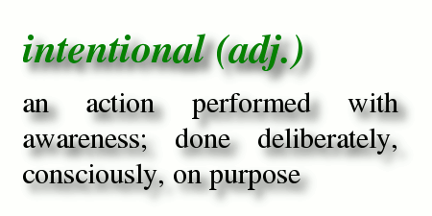
Intentionality and Commitment

Slide 5
UIW Online
Affordable Education
FREE textbooks for undergraduates
Reduced tuition for adults
No academic fees
No application fee for undergraduates
Special tuition rates for veterans and active-duty military
Accelerated Learning
Accelerated 8-week terms (6 terms per year)
100% online courses with no proctored exams in UIW Online
We schedule the courses you need to graduate on time

Slide 6
What We Do - Successes
Innovative and Responsive Programs – i.e. DBA for Professionals
Innovative Teaching & Learning, - i.e. Ellucian Brainstorm
It is about engagement - interactive and iterative discussion between instructor-student and student-student

Slide 7
Challenges- Missteps
Bureaucracy
Faculty buy-in
Instructional workload
Instructor Evaluation
The prevailing methods of instruction impede the most effective application of technology (thus the CBE)
Too much emphasis on the technology itself and lack of support for faculty
Accreditation (Digital courses/programs must follow face-to-face regulatory processes including programmatic accreditation (where appropriate)
Clear direction, sustained commitment, and financial incentives needed

